Slide 1
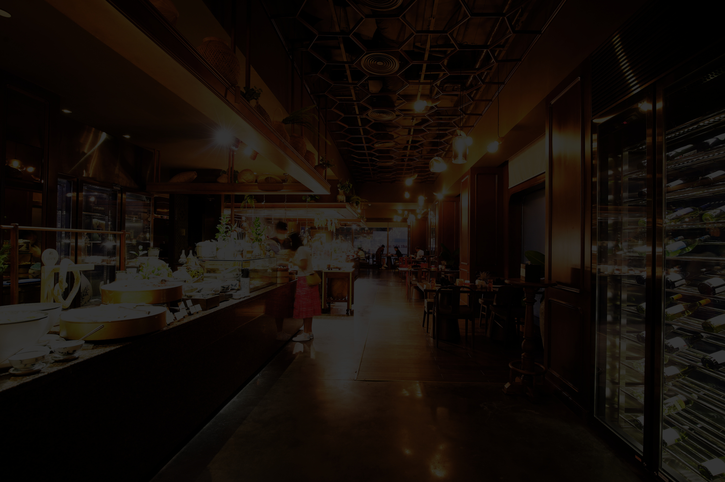

QUISINE ANALYTICS
Where Data Meets Delicious
Food Festival, Montreal 2025

Slide 2



Company Overview
Founded: In Val-d’Or, Quebec
Expansion: 84 locations across Quebec and Ontario
Fresh and ethically sourced produce
Known for bold experiments like poutine-flavored ice cream and real-time feedback integration
Unique Selling Proposition: Integration of data analytics with culinary arts to enhance customer experience and operational efficiency
MISSION STATEMENT
To revolutionize the dining experience by leveraging data-driven insights for innovative gastronomy

Slide 3
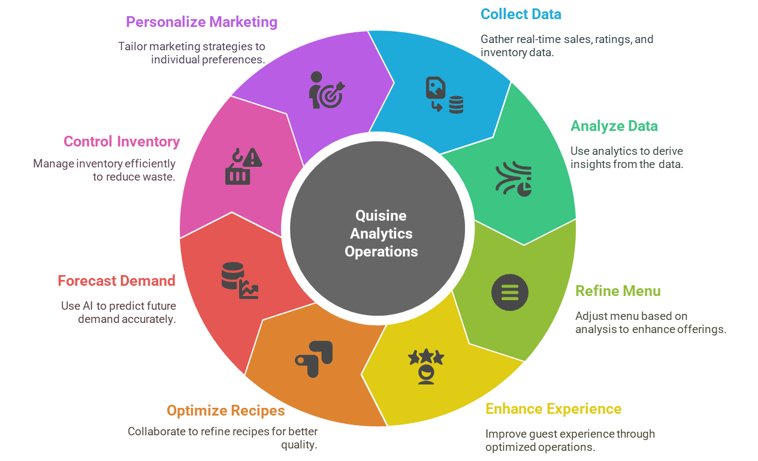

Data-Driven Operational Framework

Slide 4
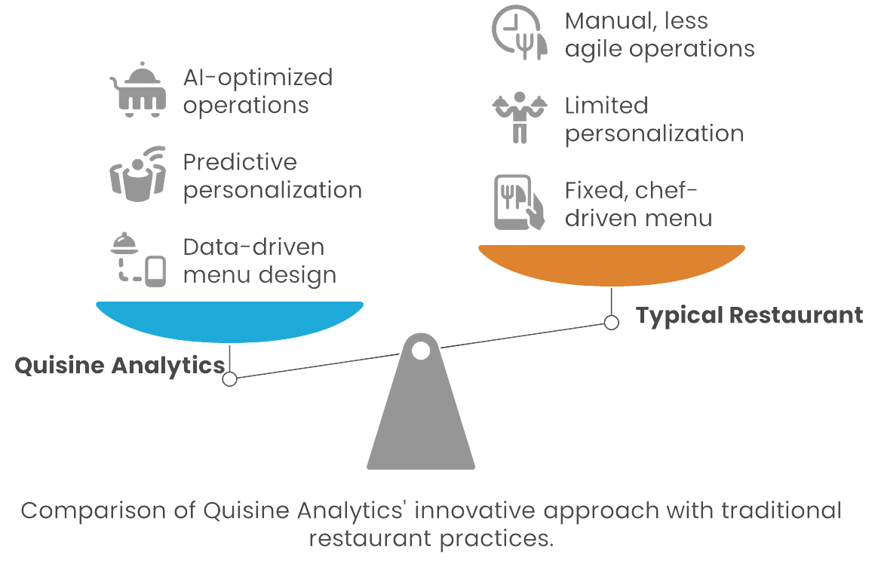

Quisine Analytics vs Typical Restaurant

Slide 5



Current Business Performance
$
8.5/ 10
$ 47
15 minutes
Customer Satisfaction Score
Average Customer Spend
Table Turnover Rate

Slide 6

Market Landscape: Quebec and Ontario
Economical Overview:
Ontario and Quebec are Canada’s leading provinces in food festival sales with Ontario experiencing a 4.3% increase and Quebec a 3.6% rise in 2024.
Consumer Trends:
76% adults prefer restaurants with locally sourced ingredients.
30% are more likely to visit establishment offering environmentally friendly food option.
Digital Engagement:
79% of diners check the menus online before visiting the restaurants.
Digital presence significantly influence dining choices.

Slide 7
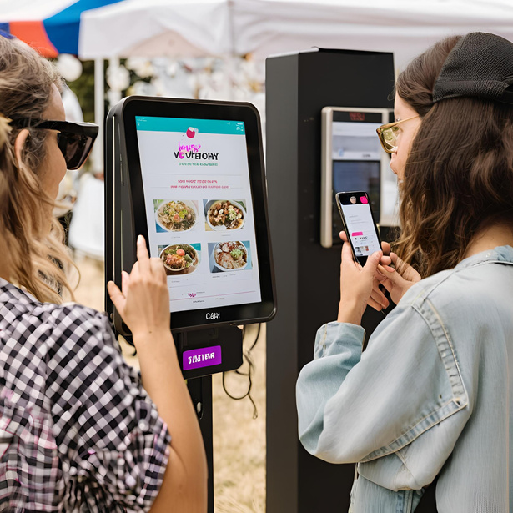
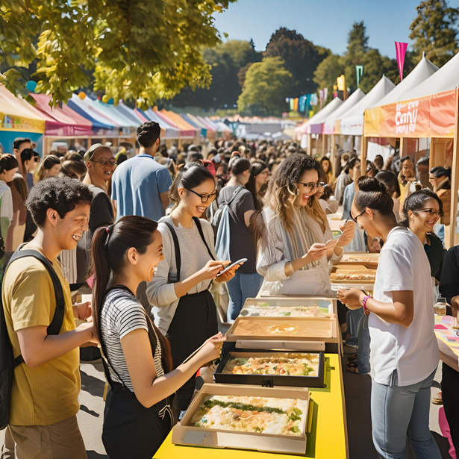
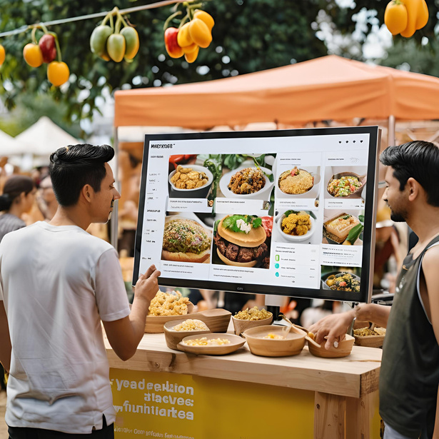
Food Festival Participation Strategy
Interactive Booth & Engagement Activities
Real-time feedback and analytics displays.
Festival attendees vote on dish variations via app/kiosk to boost participation
Interactive quizzes and feedback stations.
Digital kiosks for personalized menu recommendations.
Stream festival hashtags, live reviews, and mentions to generate community buzz
Collaborations
Partner with local suppliers to highlight sustainable sourcing practices.
Promotional Campaigns
Utilize social media and digital platforms for pre- and post-event engagement

Slide 8
Team Integration Plan
Cross Functional Collaboration
Integration Tactics
Bob
Ensures fresh, ethical sourcing & smooth supply flow
Daily Syncs
Quick stand-ups to align on insights & updates
Live Dashboards:
Real-time feedback shared across the team
Feedback Loop
Insights → Immediate service/menu adjustments
Alice
Crafts innovative dishes aligned with customer trends
Eve
Drives digital engagement & real-time tracking
Charlie
Gathers guest feedback and deliver exceptional customer service

Slide 9
Strategic Impact of Festival Participation
Increase Brand Awareness
Exposure to thousands of local and international foodies, media, and industry professionals.
Boost Customer Engagement
Quizzes, tastings, and live menu curation enable high-touch memorable interactions.
Drive Revenue Growth
High-traffic booth + 15-min turnover × $47 avg. spend = strong revenue potential.
Expand Market Presence
Test appeal in multicultural Montreal—ideal for future growth beyond Val-d’Or, Quebec, and Ontario.
Showcase Innovation
Live demonstration of our data-powered culinary model in a competitive, prestigious setting.
Collect Actionable Insights
Real-time data from guest interactions to improve products, marketing, and service.
Strategic Partnership
Build relationships with chefs, suppliers, and tech partners aligned with our values.

Slide 10

Conclusion
Our participation in the Montreal Food Festival is a strategic move to:
Enhance brand visibility
Engage with a broader customer base
Showcase our innovation in real time
Collect valuable insights for future growth
The Opportunity Ahead
With a cross-functional team, data-driven strategy, and bold vision, we are poised to:
Deliver a memorable festival experience
Solidify our reputation as a pioneer in smart gastronomy
Drive long-term success across Quebec, Ontario, and beyond
Let’s turn every data point into a delicious story.

Slide 11
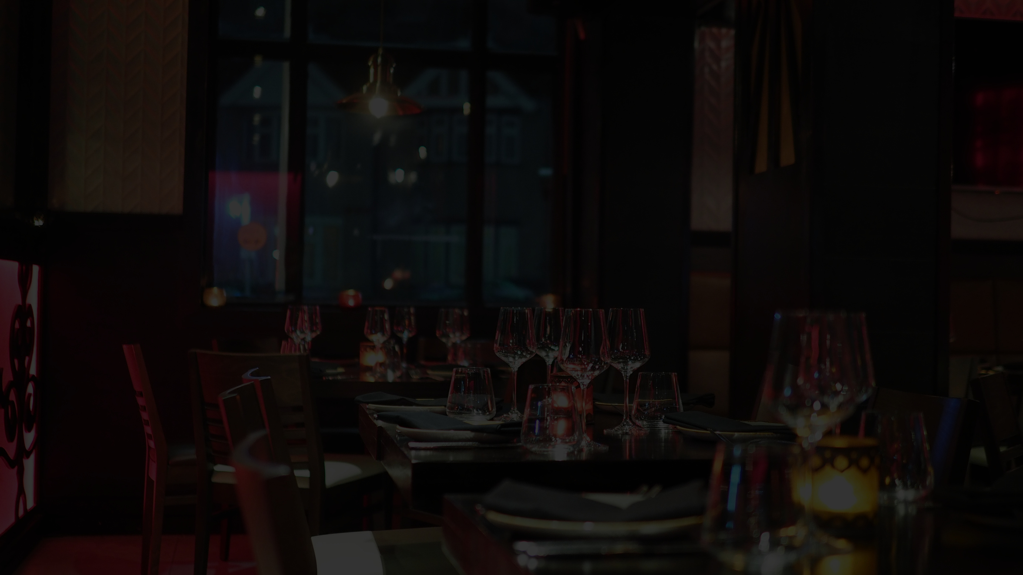
Thank You For
Your Attention

